Slide 1
Outline
Introduction - Becky
Pesticides - Chamberlain
Heavy Metals - Mikaela
Nutrients - Ryan
Sediments - Ryan
Other Pollutants - Ryan
Conclusion - Ryan

Slide 2
Stream Invertebrates as Indicators of Environmental Stressors
Rebecca Joachim, Chamberlain Segrest, Ryan Sinclair, Mikaela Howie

Slide 3
Sentinels are Biological Indicators
Biomonitoring - the process of using stream organisms as a basis for pollution detection.
  The underlying concept of biomonitoring is that certain types of stream animals occur or thrive only under certain water quality conditions and when those conditions change, the abundance and distribution of those animals in the affected site change as well.

Slide 4
Aquatic Insects
12 orders and ~11,000 species in North America – many found in Louisiana wetlands
Short life cycles, many generations per year, and habitat stasis after propagation allow for indication of recent and long term environmental conditions
  When environmental changes occur, the species must endure change and adapt quickly or die out and be replace.
  This replacement results in an overabundance of a few tolerant species

Slide 5

Diptera
Black fly larva (Family: Simuliidae). Note the brown head and single fleshy proleg.
http://www.aces.edu/department/extcomm/publications/anr/anr-1167/anr-1167.html

Slide 6
Benthic Invertebrates
Main invertebrates used as bioindicators
  They are ubiquitous.
  They are relatively sedentary and long-lived.
  Some species of benthic macroinvertebrates are sensitive to pollution and some are tolerant.
  Benthic macroinvertebrates are easy to collect and identify.

Slide 7
Diptera – True Flies
Black fly larva (Family: Simuliidae). Note the brown head and single fleshy proleg.
http://www.aces.edu/department/extcomm/publications/anr/anr-1167/anr-1167.html

Slide 8

Coleoptera - Beetles
Riffle beetle larva, left, and adult, right, (Family: Elmidae). Photo courtesy of Lara Panayotoff.
http://www.aces.edu/department/extcomm/publications/anr/anr-1167/anr-1167.html

Slide 9
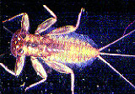
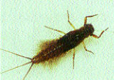
Ephemeroptera - mayflies
Figure 1. Flattened mayfly nymph (Family: Heptageniidae). Photo courtesy of Howell Daly. (left). Figure 2. Cylindrical mayfly nymph (Family: Leptophlebiidae). Photo courtesy of Ralph Charlton. (below). http://www.aces.edu/department/extcomm/publications/anr/anr-1167/anr-1167.html

Slide 10
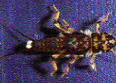
Plecoptera – Stoneflies
Figure 3. Perlid stonefly nymph (Family: Perlidae).
Figure 3. Perlid stonefly nymph (Family: Perlidae).
Figure 3. Perlid stonefly nymph (Family: Perlidae).
Figure 3. Perlid stonefly nymph (Family: Perlidae).
Perlid stonefly nymph (Family: Perlidae).
http://www.aces.edu/department/extcomm/publications/anr/anr-1167/anr-1167.html

Slide 11
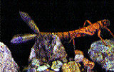
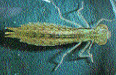
Odonata- Dragonflies and Damselflies
Damselfly naiad (Family: Coenagrionidae). Note the three leaf-like gills at the end of the abdomen. (left) Dragonfly naiad (Family: Aeshnidae). (below)

Slide 12
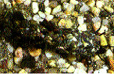
Trichoptera - Caddisflies
Overhead view of case-building caddisfly larva inside its stony case (Family: Limnephildae). Note the head and legs emerging from the case on the right side of photograph.

Slide 13
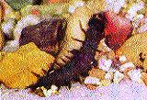
Megaloptera - Dobsonflies
Dobsonfly larva (hellgrammite; Family: Corydalidae). Note the large head and jaws and lateral filaments on abdomen. Photo courtesy of George Folkerts.

Slide 14
Process of Biomonitoring
Sampling – use dip nets or kick screens for qualitative collections of quadrat samples
Examine, taxonomically identify, and count the invertebrates
Compare inverts to samples taken in the same stream at an earlier time to identify a suspected pollutant
Compare inverts to samples from nearby polluted streams as a reference to undisturbed conditions

Slide 15
Quantifying Inverts
Species richness – number of unique types of inverts present in a sample
Abundance – total number of inverts in a sample
Relative abundance – number of invertebrates in the sample from one species relative to another species
Diversity – distribution of total individuals across species in the sample

Slide 16
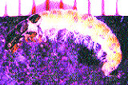
EPT Index
Most popular biomonitoring technique
Measure of three most pollution-sensitive aquatic insect orders
  Ephemeroptera
  Plecoptera
  Trichoptera
High EPT count means low levels of pollution

Slide 17
Problems with EPT-Index
Need to establish a baseline of conditions
  If this does not occur, may record variation as pollution when it is actually the geographical varying nature of stream invertebrates

Slide 18
Our Presentation
Explanation of various pollutants
The basic nature of those pollutants
How a stream invertebrate community is affected when the pollutant enters the stream

Slide 19


PESTICIDES
How They Relate To Macroinvertebrates

Slide 20
Outline
Introduction
Pesticides
Heavy Metals
Nutrients
Sediments
Other Pollutants
Conclusion

Slide 21
Table of Contents
What are pesticides?
What human activities produce pesticides?
How do macroinvertebrates respond to pesticides?
How can we monitor for pesticides?

Slide 22
What are pesticides?
A pesticide is any substance used to prevent, repel, alleviate, or eliminate a pest. The term pesticide applies to herbicides, fungicides, algaecides, and various other substances used to manage pests. Pests include any unwanted insects, plants (weeds), fungi, microorganisms, and small animals.
The Office of Pesticide Programs (OPP) within the Environmental Protection Agency (EPA) is largely responsible for the regulation of pesticides in The United States. Their mission is to evaluate potential new pesticides and uses, maintain old pesticides against current standards, encourage alternatives, and promote safe practices.
The dilemma: Despite the benefits of pesticides, they are a health risk to biota (including humans) because they are designed to adversely affect living organisms.

Slide 23

Anthropogenic Sources
HOUSEHOLDS:
Insect sprays or baits
Insect repellents for personal use.
Rodent poisons.
Flea and tick sprays, powders, and pet collars.
Kitchen, laundry, and bath disinfectants and sanitizers.
Products that kill mold and mildew.
Some lawn and garden products
Some swimming pool chemicals.
www.epa.gov

Slide 24


Anthropogenic Sources
GOLF COURSES AND ROADWAYS :
Herbicides, fungicides, and to a lesser extent insecticides, are the categories of pesticides used on golf courses. It has been found that many golf courses apply up to three times the amount of pesticides per acre when compared to farms. This overdose is purely aesthetic.
The same types of pesticides are found to be applied to roadways, although to a much lesser degree.

Slide 25
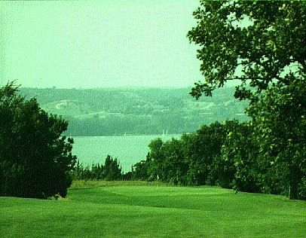
Chemicals found in Golf Courses
Insecticides: diazinon, chlorpyrifos and carbaryl
Herbicides: 2,4-D, mecoprop, and dicamba
Fungicides: quintozene; iprodione (Rovral); and chlorothalonil (Daconil)

Slide 26
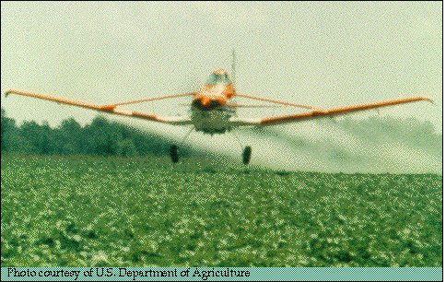
Anthropogenic Sources
AGRICULTURE:
According to the United States Geological Survey (USGS) an estimated 1 billion pounds of pesticides are used each year in the United States. Out of this figure, eighty percent is used in agriculture. Despite the increased crop yield and other benefits, the danger to humans
and other organisms
is evident.

Slide 27
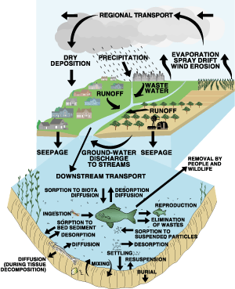
Anthropogenic Sink: Impact on Waterways
From their sources, the pesticides unintentionally enter waterways via urban and rural run-off (non point pollution). The opposing figure details pesticide movement within the hydrologic system.
Pesticides are hydrophobic and persistent and therefore accumulate in aquatic biota and sediment.
Figure 1. Pesticide movement in the hydrologic cycle including pesticide movement to and from sediment and aquatic biota with the stream. Modified from Majewski and Capel (1995).

Slide 28
Currently used (1990s) pesticides predicted to have potential to accumulate in sediment and aquatic biota
Insecticides
Herbicides
Fungicides or wood
preservatives
Chlorpyrifos²
Benfluralin
Dichlone
Dicofol^{2,3}
Bensulide
PCNB²
Endosulfan^{2,3}
Dacthal²
Pentachlorop henol²
Esfenvalerate
Ethalfluralin
Fenthion
Oxadiazon²
Fenvalerate²
Pendimethalin
Lindane^{2,3}
Triallate
Methoxychlor^{2,3}
Trifluralin2
Permethrin²
Phorate⁴
Propargite
¹ Selection criteria: (1) water solubility < 1.0 mg/L or log K_{ow} > 3, and (2) soil half-life > 30 days.
² Detected in one or more past studies of stream sediment or biota.
³ Organochlorine insecticide.⁴ Analyzed in >1,000 total samples by past studies,
but not detected.
*Graph taken from USGS webpage

Slide 29

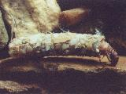
Pesticides and Macroinvertebrates
Different species of aquatic insects vary greatly in their reactions to pesticides.
Although there is no definite relationship between the inverts susceptibility and life history or morphology, some inverts have been found to have lowered resistance when they are:
Immature
Small
Molting
Caddisfly Larva in Case
Order: Trichoptera
Photo by: Cliff White
Emerging

Slide 30

Indirect Effects Of Pesticides
According to Tom Murdoch in the “The Stream Keepers Field Guide”, pesticides tend to:
Kill aquatic organisms that are not targets
Adversely affect reproduction, growth, respiration, and development in aquatic organisms
Reduce food supply and destroy habitat of aquatic species
Accumulate in tissues of plants, macroinvertebrates and fish
Some are carcinogenic (cause cancer), mutagenic (induce changes in genetic material-(DNA), and/or teratogenic (cause birth defects)
Lower organisms' resistance and increase susceptibility to diseases and environmental stress
Decreases photosynthesis in aquatic
plants

Slide 31
Indirect Effects of Pesticides
The niche spaces of aquatic microinvertebrates will vary depending on their tolerance to the pesticide. Examples:
When toxaphene (an insecticide with the approximate empirical formula C₁₀H₁₀Cl₈ that is a complex mixture of chlorinated compounds) was added to a stream in Wisconsin the elimination of several species of predatory fish was followed by a 200-fold increase in the Chironomus midge population. The population declined when the stream was restocked. (Note: The midge population would be eliminated with a higher concentration of toxaphene).
When DDT (a colorless odorless water-insoluble crystalline insecticide C₁₄H₉Cl₅ that tends to accumulate in ecosystems and has toxic effects on many vertebrates; no longer used) was added to a stream, the number of Plecoptera and Trichoptera greatly decreased. This was followed by a significant increase in black flies.

Slide 32

Tools to Monitor Pesticide Levels in Macroinvertebrates
Biochemical Measures
Physiological Measures
Morphological Measures
Behavioral Responses
Life History Changes

Slide 33
Outline
Introduction
Pesticides
Heavy Metals
Nutrients
Sediments
Other Pollutants
Conclusion

Slide 34
HEAVY METALS
What are they?
Where do they come from?
How do they affect macroinvertebrates?
How do we monitor them?

Slide 35

Heavy Metals??
Elements having atomic weights between 63.546-200.590
Specific gravity > 4.0

Slide 36

Common Heavy Metals
Cadmium Lead
Cobalt Mercury
Copper Uranium Iron Zinc
Notes:
These are heavy metals commonly found in the river system today.

Slide 37
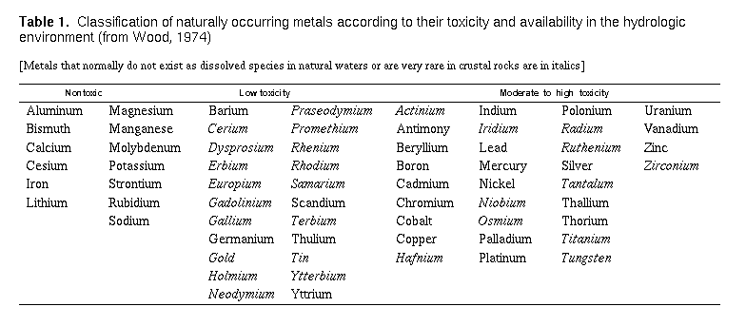
Heavy Metals Present in Natural Waters
Notes:
The chart organizes the heavy metals according to their relative toxicity. As you can see, or maybe not see, all of those listed as common are also listed under the moderate to high toxic category. Iron is the only one listed as nontoxic.

Slide 38
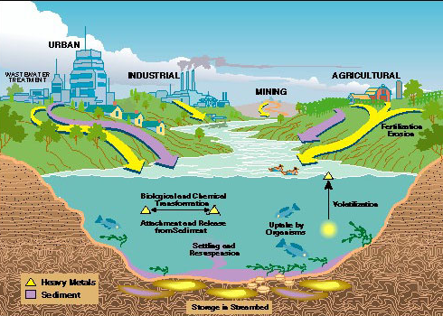
Sources and Sinks of Heavy Metals
Notes:
The main sources of heavy metals in the river system are urban, industrial, mining, and agricultural runoff. Urban waste enters the system through both direct disposal and leachage from waste dumps as well as wastewater treatment plants. Industrial byproducts normally include the most toxic of heavy metals and enter either by illegal dumping or unmonitored leakage. Some chemicals may alsobe released into the atmosphere and later precipitated out. Mining increases heavy metal concentrations by exposing metal bearing ore. Fertilizers added to agricultural lands commonly contain high metal concentrations which enter the river system either as surface runoff or as leachate which can enter groundwater aquifers contaminating our drinking water.

Slide 39

Sources:
Nonpoint Point
Natural….
  physical weathering of rocks and soils
  Decomposition of plant and animal detritus
  deposition of particles by volcanic activity
  wind erosion
  forest fires
Anthropogenic…
  Surface runoff
  Combustion of fossil fuels
  Urban stormwater
Industrial Waste
Domestic waste
Corrosion of water pipes
Sewage

Slide 40
Indications of heavy metal pollution in streams
Reduced Macro-invertebrate Abundance
Reduced Species Richness
Shift In Community Composition
  % composition of sensitive taxa and tolerant taxa

Slide 41
Sensitive Vs. Tolerant Orders
Ephemeroptera
  Mayflies
Plecoptera
  Stoneflies
Trichoptera
  Caddisflies
Chironomidae
  midges
Notes:
If sensitive species are found in the stream than it indicates clean water (rid of pollutants). But if tolerant species are found it is the first indication of high level of pollutants. Midges are classified as tolerant because they succeed in low oxygen and nutrient rich environments.

Slide 42
Relative Response of Stream Invertebrates
- Experimental study of response to increased concentrations of Cu (copper), Zn (zinc), Mn (manganese), and Pb (lead)
Baetis, Amelatus, and Paraleptophebia had the highest mortality rates
Nemouridae and Oligochaeta were mildly affected by very high metal concentrations
Chironomidae had no significant decline in density
  Chironomidae make up >80% of benthic invertebrates in tested stream
Notes:
Chironomidae are generally cited as being the most tolerant of stream macroinvertebrates but this may simply be a result of them also being the most abundant stream benthos.

Slide 43
Metals in the Water…..
“Behavior of metals in the water is a function of the substrate sediment composition, the suspended sediment composition, and the water chemistry.”
    Salinity and pH are two factors that determine the rate of adsorption and desorption of metals in the water
      Adsorption = removes metals from the water colum and stores them in the sedimet
      Desorption = returns metals to the water columsn

Slide 44

Toxic Effects”
Heavy Metal Pollution….
reduces the abundance and species richness if aquatic insects
Changes the proportional abundance of different groups

Slide 45
Sublethal effects:
Changes to internal tissues
Physiological changes
  Examples: changes in growth and development
Biochemical Changes
  enzyme activity and blood chemistry
Behavioral changes
  Ability to avoid predators, eating, swimming
Reproduction changes

Slide 46

Warning Signs Problem
High diversity, lots of pollution sensitive invertebrates
Low diversity, high #’s of invertebrates, lots of scrapers and collectors
High diversity and low #’s of invertebrates, clear water
Reduced # of all types of invertebrates
No Problemo!!
Organic enrichment from various sources
Toxic pollution (heavy metals and/or pesticides)
Major Problem!
  Stream may be too polluted by various sources to sustain aquatic life

Slide 47
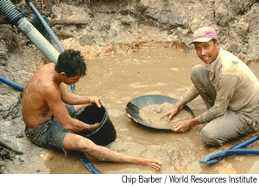
Assessment of Heavy Metal Contamination
Laboratory Toxicity Tests
Instream Monitoring
Integrated Approach
Notes:
Laboratory tests have been criticized for their lack of realism. Although laboratory tests are useful because all variables can be controlled and monitored, they ofter to not mimic the natural processes. Therfore, extrapolating from lab to nature may not give valid conclusions. Instream monitoring is useful because testing is done in the stream itself. However, limitations include lack of control on variables such as logitudinal variation between upstream and downstream sites (temperature, altitude, depth, riparian vegetation) and seasonal variation. The integrated approach involves both lab tests and instream monitoring. This approach has proven to be the most successful.

Slide 48
Variables in Assessing Response to Heavy Metals
Temperature of water
  Size of invertebrates
Altitude
  higher altitude/colder water
Abiotic Factors
  water hardness
  other pollutants
  Eutrophic vs. oligotrophic
Genetics
  short-lived
  Fast evolution rate<number>

Slide 49

Why are we Concerned???
Humans are affected Too!!
  Lead: It can cause nephrotoxicity, neurotoxicity, and hypertension
  Cadmium: Disrupts the body’s ability to maintain homeostasis
  Mercury: acute posioning causes pharyngitis, gasteroenteritis, vomiting, nephritis, hapatitus and circulatory collpase
  Arsenic: Ingestion causes vomiting, diarrhea, and cardiac abnormalitis
  Chromium: Has respiratory and dermatological effects

Slide 50
Nutrients in Streams
What are Nutrients?
What kind of human activities produce nutrients?
How do aquatic macroinvertebrates respond to nutrients?
What tools can we use to monitor them?

Slide 51
What Are Nutrients?
Nitrogen and Phosphorus.
  Nitrogen is constantly recycled in the environment.
  Atmosphere -> organisms -> atmosphere.
  Phosphorus is also naturally occurring in streams.
  Need only 5 μg/L of phosphorus and 0.3 μg/L of Nitrogen for Algae production.
  Both N and P limit algal production.
  Example: In nutrient poor tundra streams, phosphorus completely changes the stream to a more productive ecosystem. (Petersen 1985 Science).

Slide 52
How Are Nutrients Environmental Stressors / Pollutants?
Considered “Environmental Stressors” if there is increased nutrient loading.
Redfield Ratio of C:N:P (106:16:1)
Increased nutrient loading occurs from
  Fertilizer washed into streams (agriculture, golf courses).
  Effluents from municipal and industrial wastewaters, septic tanks, animal wastes and feed lot discharges

Slide 53
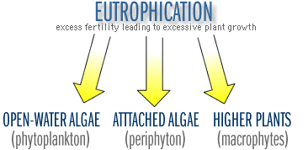
Eutrophication Defined
Eutrophication is the enrichment of a water system by inorganic nutrients primarily nitrogen and phosphorus.
It is often used to describe a polluted water body that has a low dissolved oxygen and high algal production.

Slide 54
Process of Eutrophication
Fertilizer of Agriculture
Hydrology Engineers in the 1950s-mid 1980s.
Runoff to freshwater streams
Increased abundance of algae and plants
Mats of algae with dead algae
Increased decomposition
Lower dissolved Oxygen
Increased BOD
Macroinvertebrate Population Changes
Biomonitoring

Slide 55
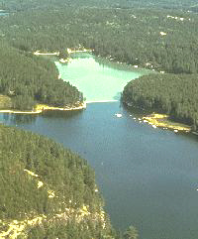
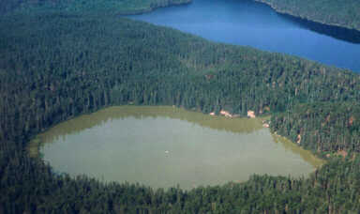
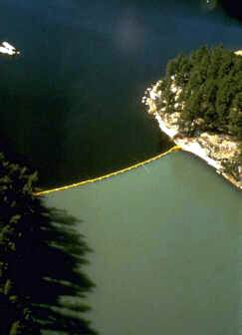
Manitoba Experimental Lakes Area
Add Carbon and Nitrogen.
Add Phosphorus, Carbon, and Nitrogen.

Slide 56
Effects of Eutrophication on Stream Communities.
  Causes longitudinal succession. Heterotrophic and autotrophic processes will be shifted upstream (Loch, Aquaculture).
  Noxious algae (scums, blue-green toxins, taste and odor, visual)
  Possible loss of macrophytes (via light limitation by algae and periphyton).
  Low dissolved oxygen (loss of habitat for fish and invertebrates)
  Excessive organic matter production (smothering eggs and reducing habitat)
  Other human related considerations (Water quality, Methemoglobinemia, production of trichloroamines)

Slide 57
What kind of human activities produce nutrients?
Land use (non-point source)
Treatment plant effluent (point source)

Slide 58
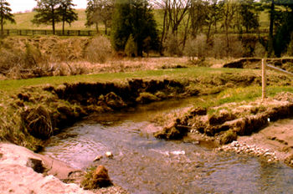
Land use (non point source)
Riparian zone cut down
Fertilizer run off
Soil compaction

Slide 59
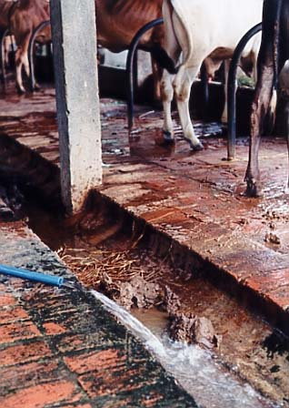
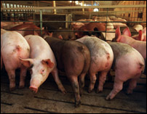
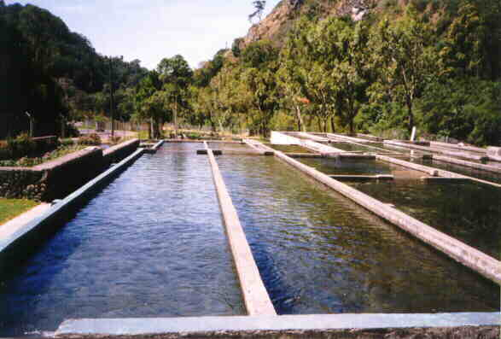
Treatment plant discharge
(point source)
Municipal and Industrial waste effluent.
Pig farms, poultry farms, trout farm discharges.

Slide 60
Pathway of Nutrients to Streams
Nitrogen or Phosphorus in Fertilizer and applied to field
Organic matter in streams from allochthounous and autochthonous inputs
Grain production
Grain fed to poultry
Nutrient fixing by microbes
Rain runoff through agriculture fields
Concentrated Poultry waste
Non-point source
Farm effluent or rain runoff through farm
Unmodified River Continuum
Eutrophication
Point source
Nutrients in Streams

Slide 61
Point source nutrient loading
What a trout farm can do to a stream.
  higher concentration of suspended solids (food for invertebrates)
  reduced dissolved oxygen levels from fish respiration within the farm, and, increased biochemical oxygen demand (BOD)
  higher concentrations of nitrate and phosphate, with potentially toxic levels of ammonia

Slide 62
Point source vs. non point source?
streams are more resilient to a local point-source nutrient addition because upstream organisms are more readily available as potential re-colonizers

Slide 63
Macroinvertebrates response to Nutrients
Mild = grazing mayflies, filter feeding black flies, Hydropsychid caddisflies, and deposit feeding Chironomids.
Extreme = lots of silt, no habitat, very low dissolved Oxygen.

Slide 64
Invertebrates as monitors of Nutrients
Saprobien system
Trent Biotic Index
Chironomid Exuvia
Community diversity indexes
EPT index tolerance scores
Other Methods

Slide 65
Saprobien System
Sample the macroinvertebrate community and consult one of the following tables tables to determine what trophic zone the water is. The four trophic zones are as follows:
  Polysaprobic
  Alpha- and beta-mesosaprobic
  Oligosaprobic
Limitations
    It doesn’t work in turbulent streams and systems receiving toxic or nonbiodegradable waste.
    Limited to evaluating sewage effects (it was developed around sewage polluted streams in Europe- popular in Germany).
    Doesn’t consider local factors that may change the dynamics of the stream such as substratum effects (Johnson, et.al, 1993).
    It requires a high degree of taxonomic expertise

Slide 66
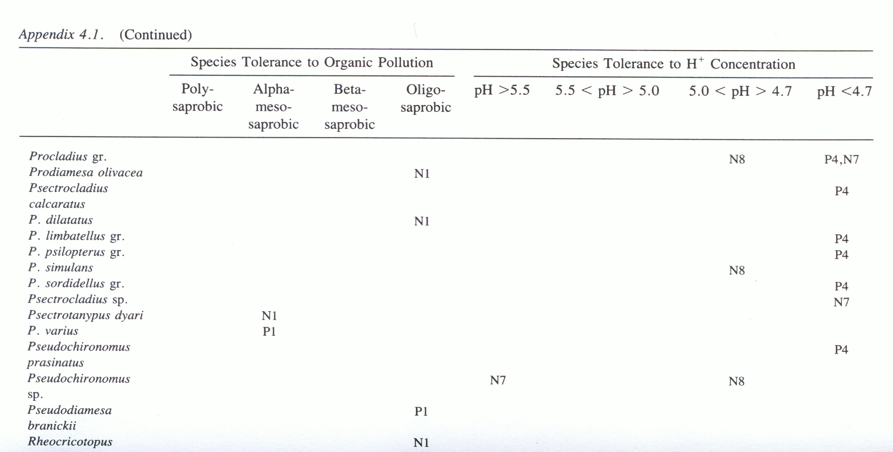
Saprobien System
Tolerances of Individual species to Organic / nutrient pollution and Acid concentration.
Johnson R.K., Wiederholm T., and Rosenberg D.M. 1993. Freshwater Biomonitoring Using Individual Organisms, Populations, and Species Assemblages of Benthic Macroinvertebrates. In Freshwater Biomonitoring and Benthic invertebrates by Rosenberb D.M. and Resh V.H. pg 80-85, 91-93. Chapman and Hall, London.

Slide 67
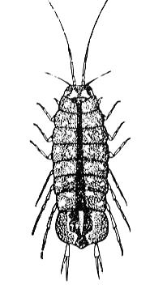
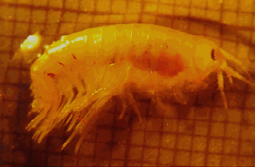
Trent Biotic Index
It ranks certain macroinvertebrate indicator taxa in stream systems according to the relative abundance (or presence/absence). Rankings are made according to the presence/absence of six groups of key organisms:
Plecoptera nymphs,
Ephemeroptera nymphs;
Trichoptera larvae;
Gammarus (amphipod);
Asellus (water louse); and
Tubificids (worms) and/or red chironomid larvae.
Limitations
  Insensitive to certain habitats
  Gives erroneous results
Water louse
Gammarus

Slide 68
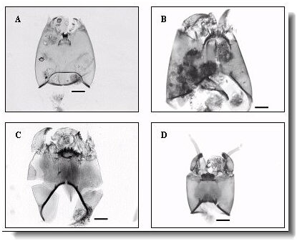
Chironomid exuvia
As the severity of organic / nutrient pollution increases, there is a predominance of Chironomus riparius pupae.
Limitations
It is limited for use of evaluating zones of recovery because Ch. Riparius pop. rapidly decline with modest improvements (Johnson, et.al, 1993).
Daily monitoring of a water body to get the emergence (hatching or exuviating) of the midge flies.
Microphotographs of subfossil chironomid remains from lakes in the Greenland region. Head capsules of the four most common subfamilies/tribes are shown. A: Tanypodinae B: Orthocladiinae C: Chironominae(tribe Chironomini)D: Chironominae(tribe Tanytarsini). Scale bar is 100 µm.
Limnology in Greenland. Klaus Peter Brodersen. http://grepalim.homestead.com/snapshots.html

Slide 69
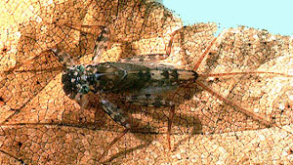
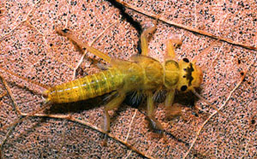
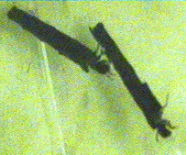
EPT Index
A rapid method, which evolved from principles of the Trent biotic score and Saprobien index. The sensitive group of macroinvertebrates known as the Ephemeroptera-Plecoptera-Trichoptera families can be used because they can typically only tolerate oligotrohpic, or non-polluted streams.
Ephemeroptera (mayfly)
Plecoptera (stone fly)
Trichoptera (caddisfly)
Limitations:
Because the families of Ephemeroptera, Plecoptera, and Trichoptera are sensitive, the EPT index tolerance scores doesn’t describe the detail of pollution below the oligotrohpic level. For this reason it is important to use this method in conjunction with other parameters.

Slide 70
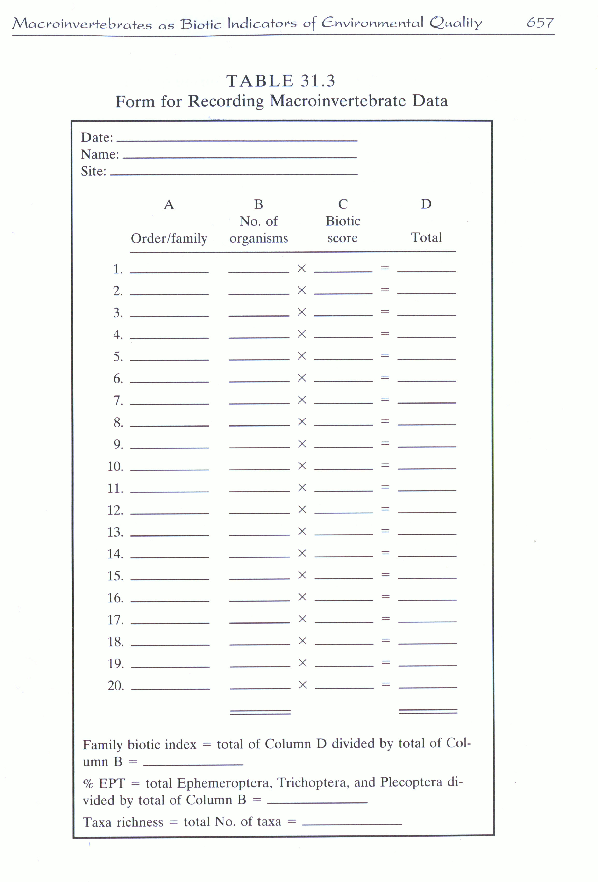
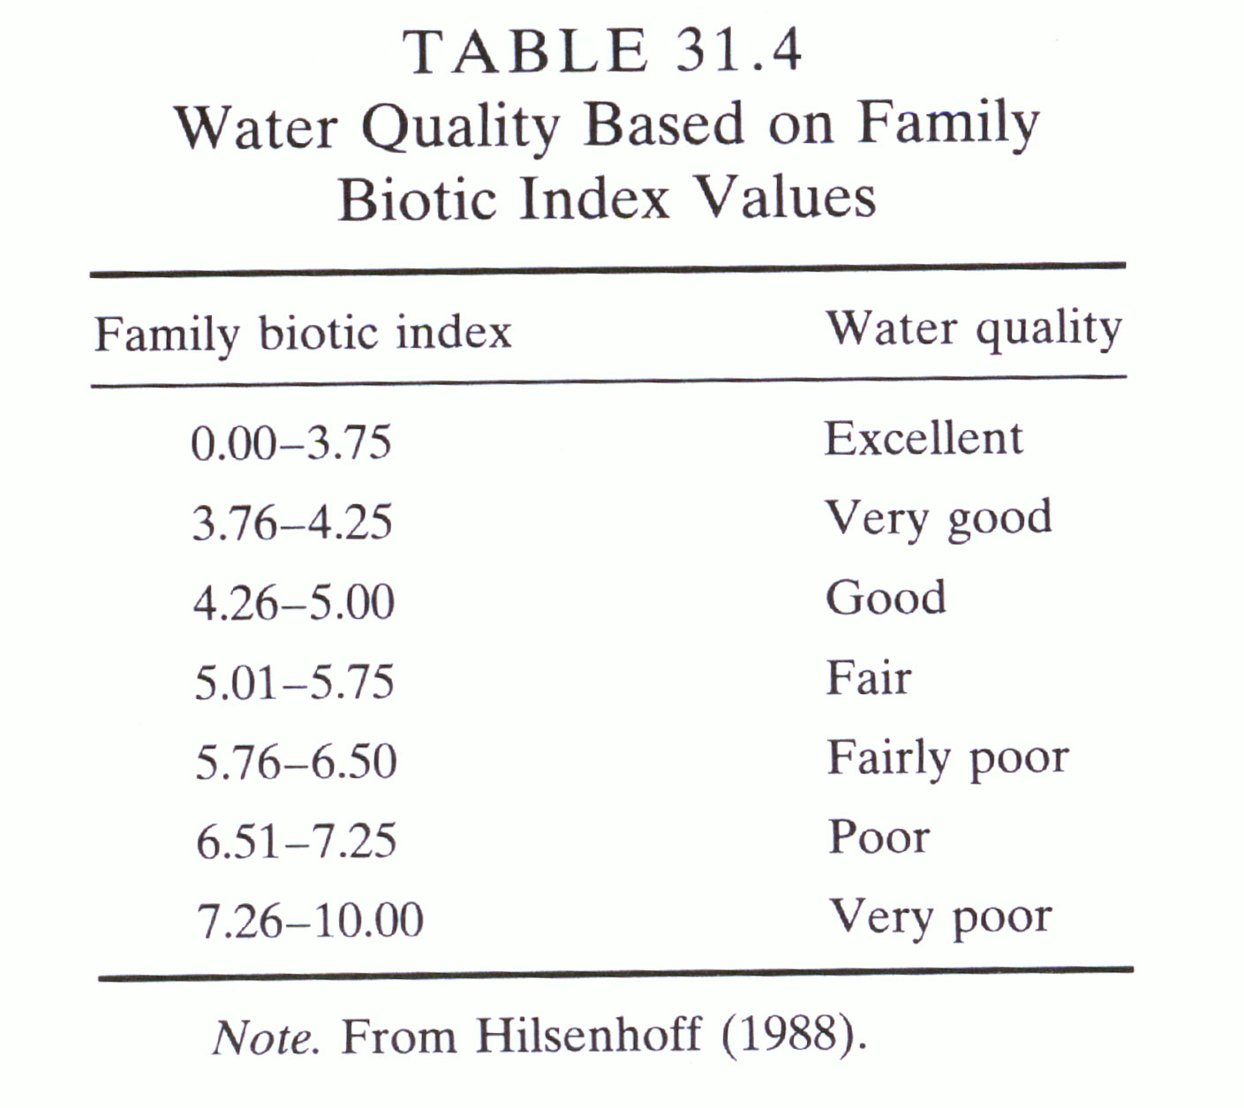

Slide 71
Other Methods
Toxicity Tests.
Toxicity tests of Nitrogen and Phosphorus on Macroinvertebrates are not common. The EPA has large datasets on toxicity of Nitrogen and Phosphorus on Fish, but very few data on Macroinvertebrates.
Diversity / Population tests
Simple comparative density and diversity measurements can be used to assess the effect of an anthropogenic pollution event.

Slide 72
Outline
Introduction
Pesticides
Heavy Metals
Nutrients
Sediments
Other Pollutants
Conclusion

Slide 73
Sediments
Fine inorganic sediment is defined as being inert and less than 2mm (Relyea, 2000). It is naturally produced as surface erosion from watersheds and introduces small amounts of particulate material into a stream.
Human Activities to produce sediment:
  Logging.
  Mining.
  Agriculture.
Macroinvertebrates Response.
  Direct.
    Obstructs respiration.
    Interferes with Feeding.
  Indirect.
    Decrease food sources.
    Decrease attachment substrate.
    Fill interstices with substrate.
    Pollutants and toxins associated with sediments.
  Most insects respond by drifting down stream (Relyea, 2000).

Slide 74
Biomonitoring of Sediment
EPT.
  Good to detect the presence of a very low level of sedimentation. These benthic macroinvertebrates drift after this. EPT can not be used to measure different levels of sedimentation.
Biotic Indexes.
  Biotic indexes are developed to measure different levels of sedimentation on different organisms.
Ecological Statistical measurements.
  Classical ecological measurements of Density, Diversity, species number, Eveness are useful in an integrative approach with Physiochemical measurements.
Other Methods.
  Toxicity tests, or other methods mentioned below in conclusion can be used in conjunction with physiochemical methods.

Slide 75
Other pollutants
Acidification
  Caused by combustion of fossil fuels and the long distance transport of pollutants . Areas with slowly weathering bedrock and poorly buffered soils are sensitive and acid rain is a serious problem in South eastern Canada and north US. Mayflies are very sensitive indicators (see Saprobien table).
Organic Enrichment
  Organic pollution is generally used in the same context as Eutrophication, as it comes from similar sources of nutrient pollution (effluents) and causes a higher BOD.
Temperature changes
  From industrial discharges (cold water from power plants or reservoirs); agriculture, forestry, and urbanization; Removal of riparian vegetation; channelization.

Slide 76
Outline
Introduction
Pesticides
Heavy Metals
Nutrients
Sediments
Other Pollutants
Conclusion

Slide 77
Conclusion
Many other measurements can be made:
  Energy metabolism
  Physiological indicators
  Scope of growth technique to monitor deformities
  Biochemical indicators
  Behavioral changes
  Life history changes
  Sentinel organisms
Which ones to choose?
  An approach that uses several different measures is likely to be a greater value, than an approach that limits itself to one method (Plafkin et al. 1989).
Are there any “Standard Methods” for Biomonitoring with Macroinvertebrates?

Slide 78
The Standard Methods for the examination of Water and Wastewater (for engineers and environmental health).
  Benthic Macroinvertebrate section only 20 pages long.
  Recommends using diversity, community metrics, pollution indicators, biomass estimates.
  Advocates an integrative approach using physiochemical indicators, habitat measurements, and biological indicators.
Freshwater Biomonitoring And Benthic Macroinvertebrates (for ecologists).
  Advocates using Benthic Macroinvertebrates and habitat measurements with few physiochemical measurements.

Slide 79
Trend of Biomonitoring.
  A shift towards establishing specific methodolgies easily replicatable in identical systems.
  Nepal Study.
Trend towards integration.
  Engineers now including biomonitoring.
  Ecologists including Physiochemical parameters.

